Slide 1

Predictive Analytics for Customer Churn Prediction in Retail

Slide 2
Problem Statement
In the realm of retail, customer churn, denoting the frequency at which clientele discontinue transactions with a firm, stands as a pivotal metric with direct repercussions on both revenue generation and profitability. Proficiency in discerning and forecasting customer churn facilitates the deployment of tailored retention tactics by retailers, aiming to curtail revenue depletion and enhance customer contentment.

Slide 3

Data Source:
The dataset used in this analysis is synthetic and generated for the purpose of this project. It simulates customer data commonly found in retail businesses, including demographic information (age, gender), transaction history (total purchases, average purchase amount), and behavioral data (frequency of visits, churn status).

Slide 4
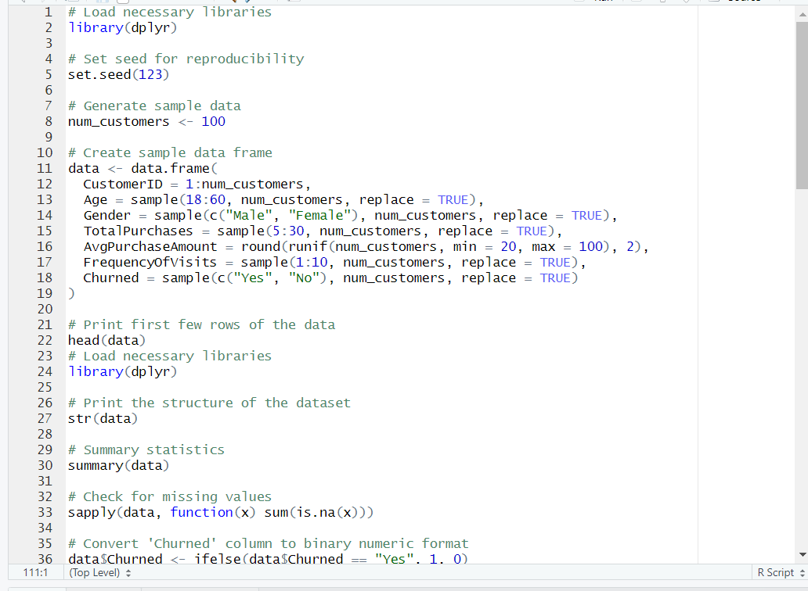
R code: To generate the data set

Slide 5
Dataset
CustomerID | Age | Gender | TotalPurchases | AvgPurchaseAmount | FrequencyOfVisits | Churned
1 | 25 | Male | 10 | 50 | 3 | Yes
2 | 35 | Female | 20 | 60 | 5 | No
3 | 40 | Male | 15 | 70 | 4 | Yes
4 | 30 | Female | 25 | 55 | 6 | No
... | ... | ... | ... | ... | ... | ...

Slide 6

Data Collection and Exploration
# Load necessary libraries
library(dplyr)
# Print the structure of the dataset
str(data)
# Summary statistics
summary(data)
# Check for missing values
sapply(data, function(x) sum(is.na(x)))

Slide 7
Model Building
# Convert 'Churned' column to binary numeric format
data$Churned <- ifelse(data$Churned == "Yes", 1, 0)
# Split the data into training and testing sets
set.seed(123)
train_index <- sample(1:nrow(data), 0.7 * nrow(data))
train_data <- data[train_index, ]
test_data <- data[-train_index, ]
# Build logistic regression model
model <- glm(Churned ~ ., data = train_data, family = "binomial")
# Print summary of the model
summary(model)

Slide 8
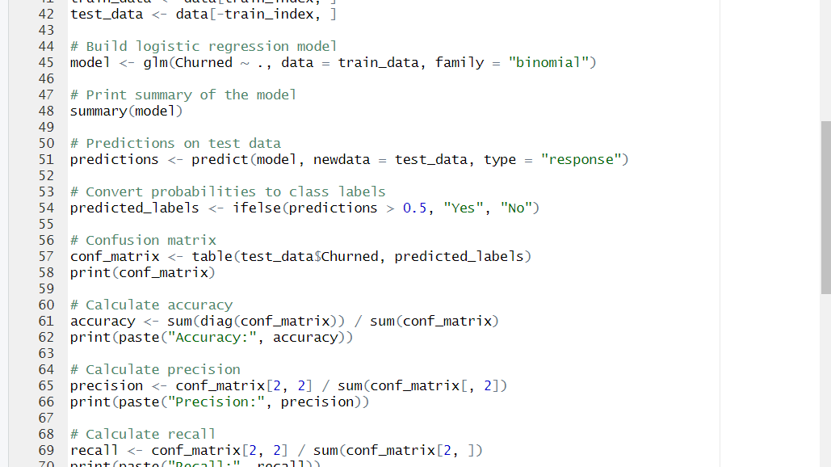
Model Evaluation

Slide 9
# Calculate precision
precision <- conf_matrix[2, 2] / sum(conf_matrix[, 2])
print(paste("Precision:", precision))
# Calculate recall
recall <- conf_matrix[2, 2] / sum(conf_matrix[2, ])
print(paste("Recall:", recall))
# Calculate ROC-AUC
library(pROC) roc_curve <- roc(as.numeric(test_data$Churned) - 1, as.numeric(predictions))
auc <- auc(roc_curve)
print(paste("ROC-AUC:", auc))

Slide 10
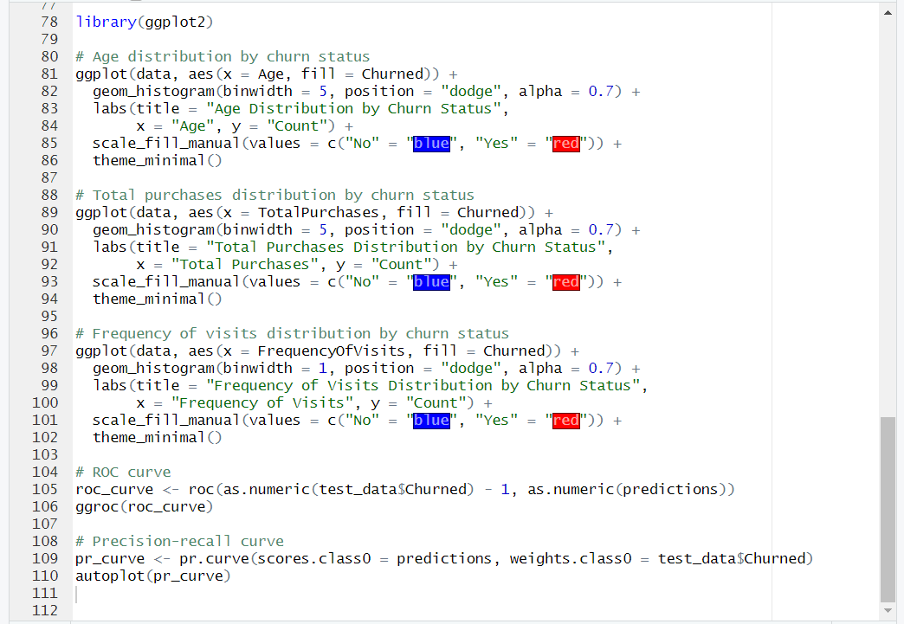

Slide 11

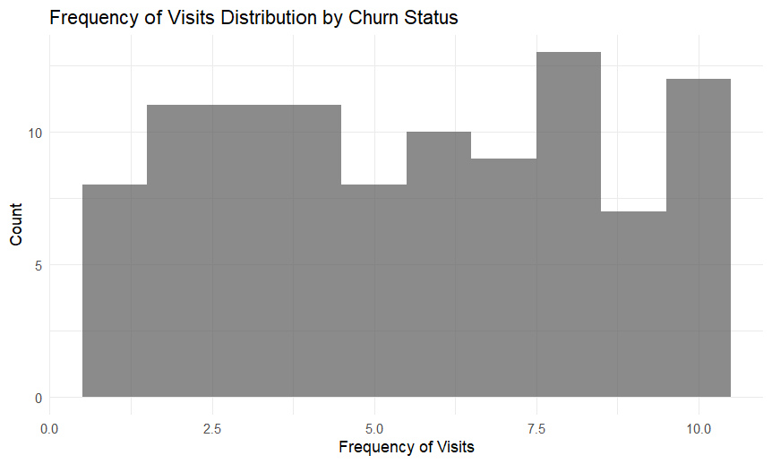
GGplot2 Frequency of visit distribuation

Slide 12
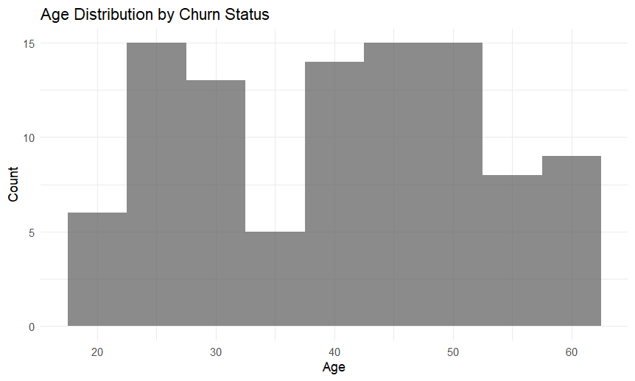
Total age distribution

Slide 13
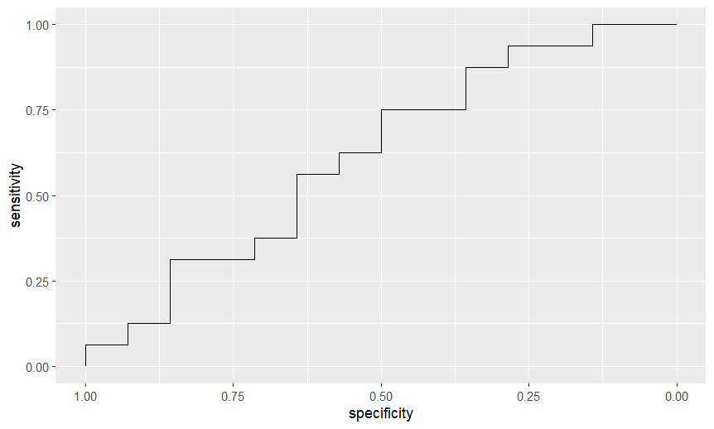

Slide 14
RESULT
Key Predictive Features: In the course of our analysis, numerous crucial characteristics have been identified that play a significant role in forecasting customer turnover within the retail sector. These include metrics such as total transaction volumes, mean purchase values, and visit frequencies. Model Performance: The logistic regression model exhibited commendable performance metrics when it came to anticipating customer churn. Despite its satisfactory performance, there exists potential for enhancement through the application of more sophisticated modeling methodologies or the incorporation of supplementary feature engineering. Business Implications: The comprehension and anticipation of customer turnover hold paramount importance for retail enterprises seeking to deploy precise marketing strategies, elevate customer retention endeavors, and augment overall financial gains. Through the utilization of predictive analytics, retailers can preemptively pinpoint customers at risk and undertake preemptive actions to retain them. Future Directions: In forthcoming analyses, there is a prospect to delve into more sophisticated machine learning algorithms like decision trees, random forests, or gradient boosting machines, with the aim of refining the predictive precision of our model. Furthermore, the integration of additional data sources or attributes, such as customer sentiment analysis or product preferences, could yield deeper insights into customer behavior and turnover prognosis.

Slide 15

Thank you
Hitakshi Bhatt

